Slide 1

Business Model Canvas
Camp Manager
Notes:
Joel

Slide 2
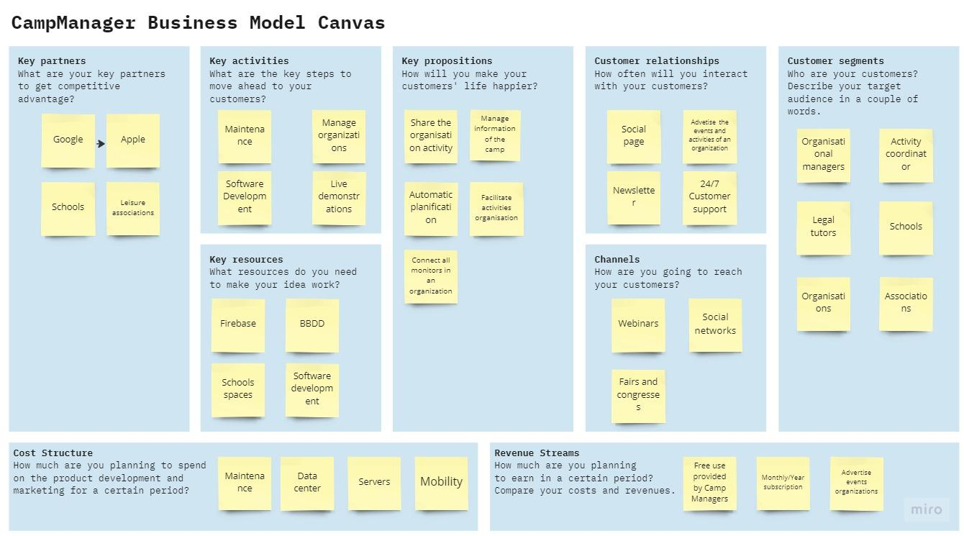
Notes:
Joel

Slide 3



Notes:
Joel

Slide 4



Notes:
Alejandro

Slide 5


Notes:
Alejandro

Slide 6


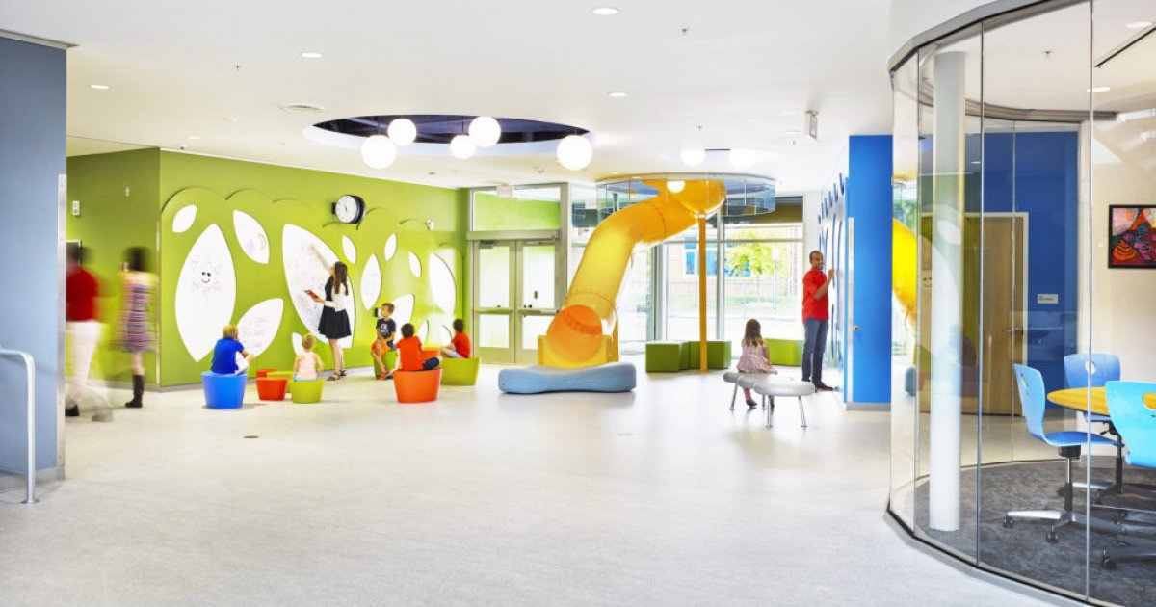
Notes:
Alejandro

Slide 7

Notes:
Jordi

Slide 8

Notes:
Jordi

Slide 9


Notes:
Jordi

Slide 10

Notes:
Carlos

Slide 11

Notes:
Carlos

Slide 12
Notes:
Carlos

Slide 13
Thank You
Camp Manager
Joel Aumedes
Alejandro Clavera
Carlos Isaac
Jordi Lazo
Notes:
Carlos

